Slide 1
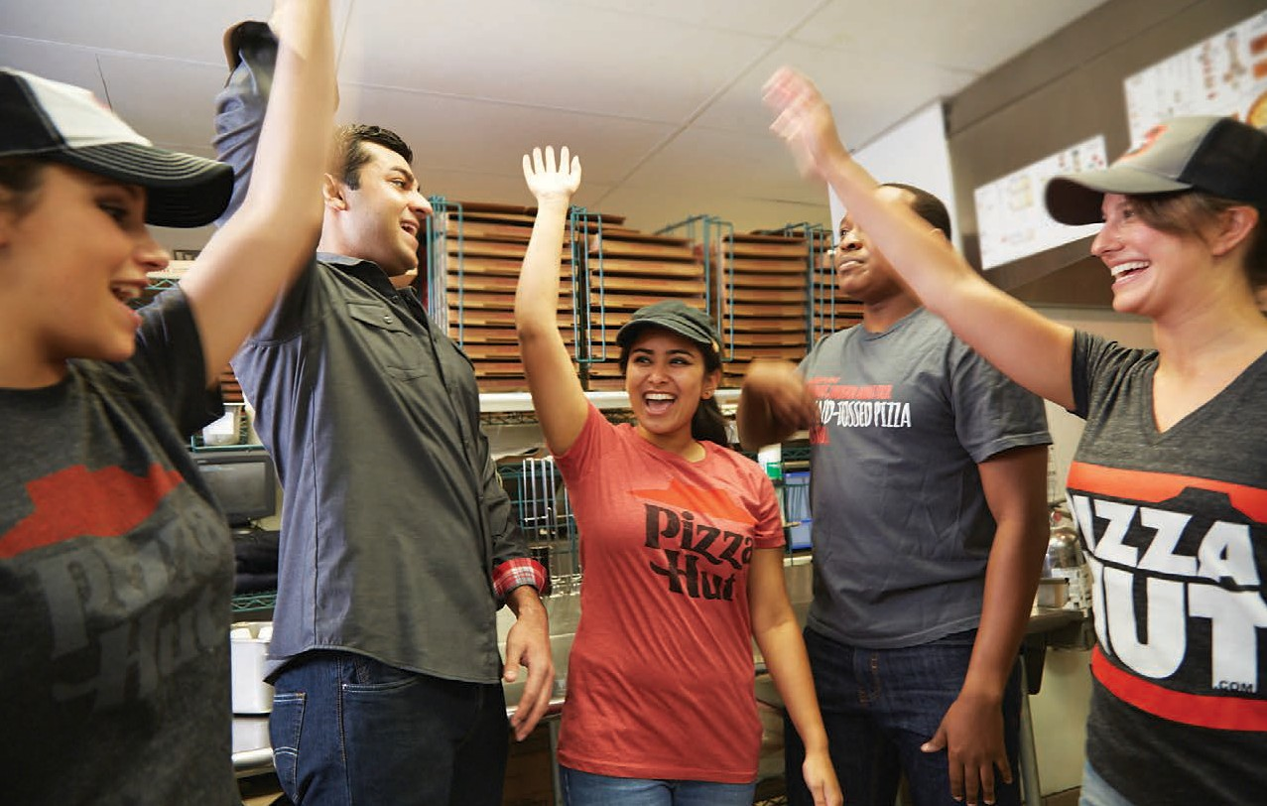

Build a team that makes anything possible.
An RGM’s Guide: Five steps to attracting and retaining top talent.

Slide 2




1. Know your target
Today’s job seekers aren’t just looking for a job. They’re looking for a fast track to their dreams — whether that’s buying a phone, paying for college, or anything in between. Whatever they’re after, Pizza Hut makes it possible.
Good employees are also looking for something to get excited about. Something they can get behind. And for those who love pizza as much as we do, there’s no better place to start.
People who love pizza — and love to serve — are a great fit at Pizza Hut!
2. Know our brand
"Life Unboxed" is the experience we deliver to our team. Life Unboxed means you can start here and end up anywhere. It means you can lose the limits and go for what you’re after. And it means you can have a job where you make friends, have fun, and become your very best — all while providing a stellar customer experience.
We’re committed to helping our people unlock their potential and go even further than they thought they could — while also making sure our customers are well taken care of. This piece shows how you can bring Life Unboxed to life for each of your employees.
Before every interview, consider looking through our Life Unboxed booklet and reviewing Our Promise, Our Culture, and Our Service principles. These help set the tone for the kind of employers we are and the kind of people who will thrive at Pizza Hut. You can also give the booklet to team members when they onboard.
THIS IS
Have you seen all of our Life Unboxed resources?
If not, visit hutlink.yum.com and select “Marketing Center” from the Quick Links ( ) menu on the top right hand side. You can also order your Life Unboxed back-of-house materials on the Market Place.
It Happens at the Hut
We want talented and visionary people to know that whatever they’re looking for, whatever “it” they’re seeking, Pizza Hut is where it happens. It Happens at the Hut is the phrase we use in our recruitment materials to invite job seekers into our Life Unboxed culture.
See p. 4 for more information about It Happens at the Hut
recruitment resources.

Slide 3
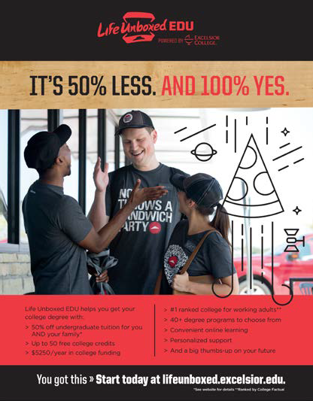
3. Know what sets Pizza Hut apart
So how do we stand out from the job down the street? Here are three of our biggest differentiators as employers:
Our Mojo
There’s nothing cookie-cutter about Pizza Hut. Not our pizzas. Not our people. And definitely not the way we do life.
We aren’t for people who want to blend in. We’re for those who are ready to break free.
As a Pizza Hut leader, you make our mojo more than just words. You help our people unlock their potential, follow their dreams, accomplish their goals, and become their very best. You help them lose the limits and go for what they’re after.
Life Unboxed EDU
As part of our commitment to help team members unlock their potential and become their best, we’re proud to offer and support the Life Unboxed EDU initiative. With this unique program, employees at Pizza Hut restaurants — and their families — get more than 50% off tuition at Excelsior College, the #1 ranked college for working adults.*
This innovative degree program provides a convenient online-
learning format that fits around a work schedule, plus:
Up to 63 free college credits for Pizza Hut on-the-job and/or Learning Zone training
40+ degree programs to choose from
Personalized support
Most employees in the Life Unboxed EDU program leverage credit received from their Pizza Hut training toward a Bachelor of Professional Studies in Business and Management and can finish this track quickly — faster than any other degree option.
Learn more at lifeunboxed.excelsior.edu.
Endless Career Opportunities
No matter where they start, team members have unlimited chances to build a promising career at Pizza Hut. High performers can move into anything from restaurant management to corporate and franchise positions to owning their own franchise.
Learn more at jobs.pizzahut.com or explore success stories on Hut Life at blog.pizzahut.com.

Slide 4
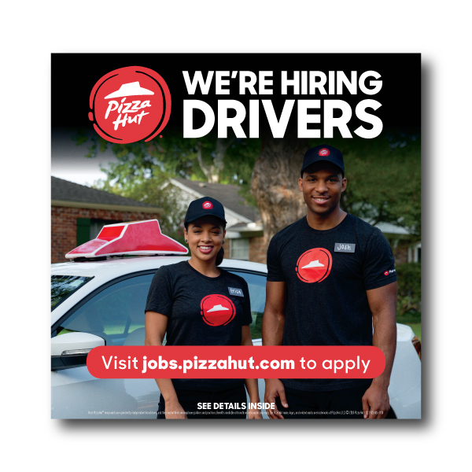
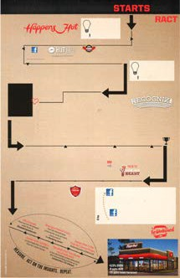





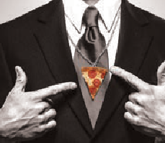
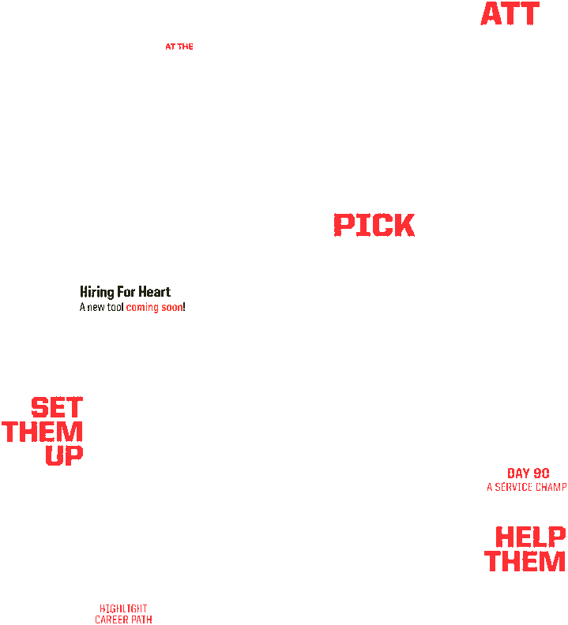
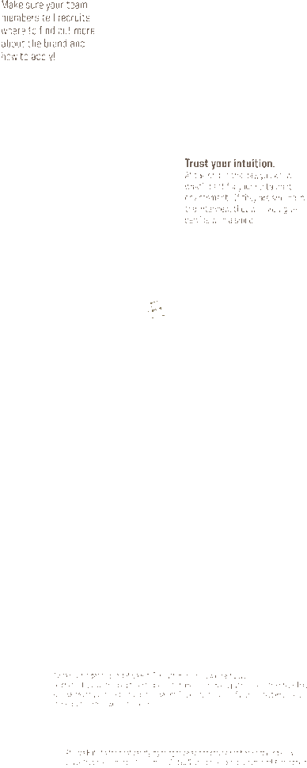
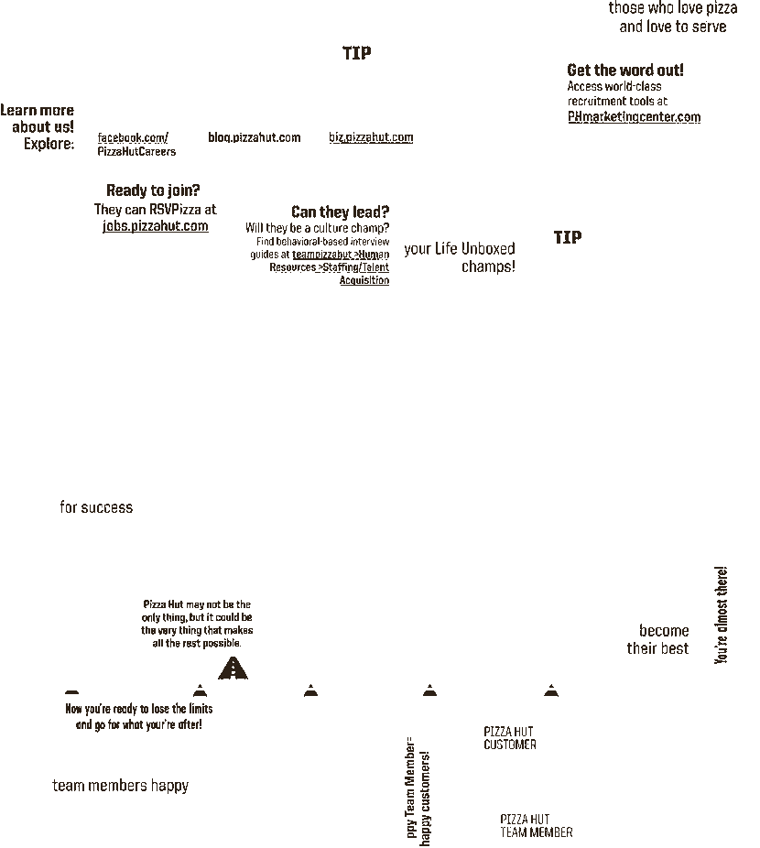
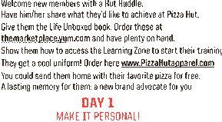
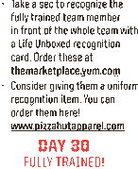
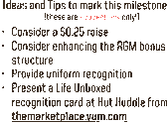


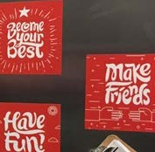
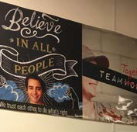





4. Know your resources
We’ve developed a toolkit of It Happens at the Hut recruitment materials to help support you in attracting great applicants: You can find and order these materials in the recruitment section on the e-store at phmarketingcenter.com.
Recruitment Kit for Hiring (All Positions)
Building Signage
Real Estate/Yard Sign
Building Banner
Feather Banner
Pop-up Banner
Sidewalk Sandwich Sign
Front of House Materials
Door Clings
Life Unboxed EDU Poster
Advertising
Print Ads
Digital Ads
Digital Videos
Additional Resources
Scouting Cards
Boxtoppers
Buck Slips
Driver Car Window Decal
Other Recruitment Materials
Your Roadmap to Life Unboxed This one-pager walks you through everything from attracting to onboarding to developing high-performing team members with a Life Unboxed focus. Find this helpful guide on the Life Unboxed page on Hut Link.
Back of House Life Unboxed Materials
When you prominently display Life Unboxed messaging in the back of house, prospective employees will pick up on the excitement of what’s possible at Pizza Hut. Visit the Market Place to order and to stay current on what’s available!
YOU’RE THE
Recruitment-Ready Checklist
Is your store ready to attract and keep the best possible people? We’ve developed a complete checklist to help keep you prepared. Find it today on Hut Link.
BOSS,
MARINARA SAUCE.
LIFE
Let’s lose the
We know Pizza Hut may not be your only thing, but
it might be the very thing that makes the rest of it possible.
we’re after. UNBOXED
LIFE
UNBOXED
limits. And
go for what
CREATE FOOD WE’RE PROUD TO SERVE
Not all of us at Pizza Hut are making pizza, but all of us are making pizza better. Whatever we’re each creating, we deliver it with three goals in mind: Give service with a smile. Because we’re making people happy. Deliver it fast. Because #IWWIWWIWI. And, above all, always: Create food we’re proud to serve. Because anything less won’t do.

Slide 5
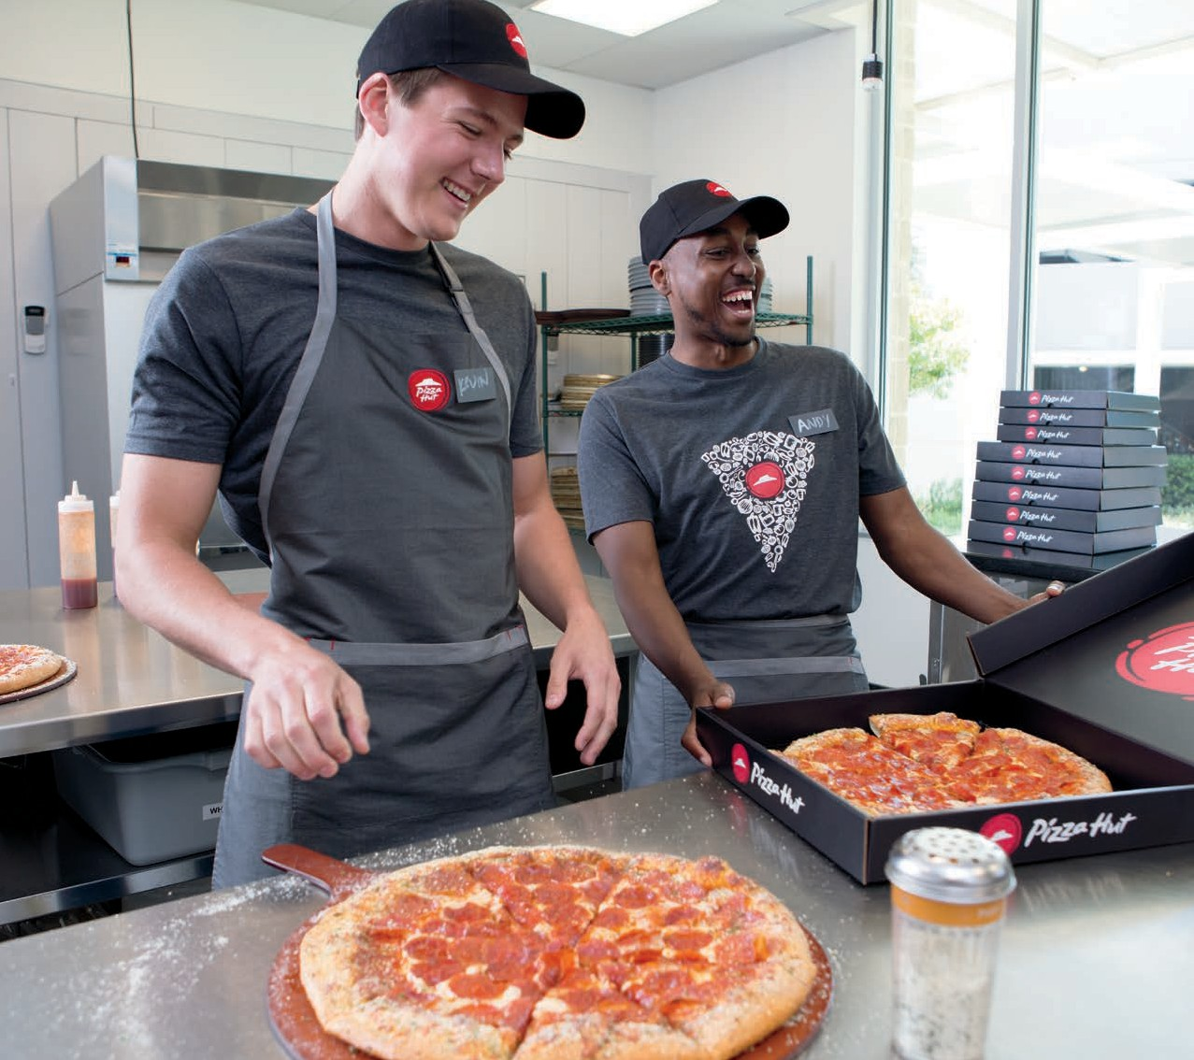
5. Bring it to life
You are the heart and soul of Life Unboxed. You’re the reason It Happens at the Hut. And you have everything you need to attract an outstanding team — the kind that gives service with a smile, creates food we’re proud to serve, and delivers it fast (and hot!).
Now it’s up to you and the team to make it happen.

